Slide 1


Introduction to NLP
Video 3 : NLP Libraries

Slide 2
NLP Libraries
RE
PyTorch
NLTK
TensorFlow
NLP
Libraries
Hugging Face Transformers
SpaCy
Gensim
Scikit-Learn

Slide 3
NLP Libraries
RE
PyTorch
NLTK
TensorFlow
NLP
Libraries
Hugging Face Transformers
SpaCy
Gensim
Scikit-Learn

Slide 4
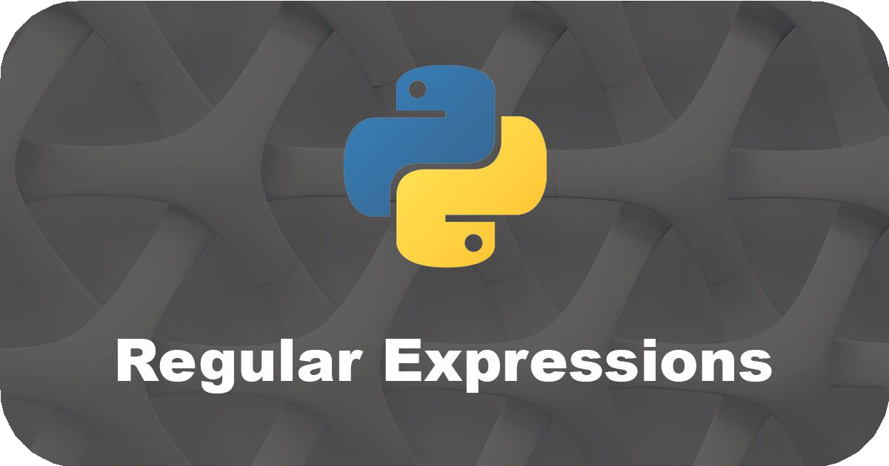
1. Regular Expression (RE)
Language-agnostic standard for
processing and manipulating text
Used in tasks like searching, replacing and parsing text data

Slide 5
NLP Libraries
RE
PyTorch
NLTK
TensorFlow
NLP
Libraries
Hugging Face Transformers
SpaCy
Gensim
Scikit-Learn

Slide 6

2. NLTK
Works with human language data
Tools for tokenization, stemming, tagging classification

Slide 7
NLP Libraries
RE
PyTorch
NLTK
TensorFlow
NLP
Libraries
Hugging Face Transformers
SpaCy
Gensim
Scikit-Learn

Slide 8

3. SpaCy
Designed for features like Named entity recognition, part-of-speech tagging
Library of pre-trained models for
several languages.

Slide 9
NLP Libraries
RE
PyTorch
NLTK
TensorFlow
NLP
Libraries
Hugging Face Transformers
SpaCy
Gensim
Scikit-Learn

Slide 10

4. Gensim
Task like topic modeling, document indexing and similarity retrieval
Word embedding to capture semantic relationships

Slide 11
NLP Libraries
RE
PyTorch
NLTK
TensorFlow
NLP
Libraries
Hugging Face Transformers
SpaCy
Gensim
Scikit-Learn

Slide 12

5. Scikit-Learn
Tools for machine learning and statistical modeling including classification, regression, clustering and text analysis

Slide 13
NLP Libraries
RE
PyTorch
NLTK
TensorFlow
NLP
Libraries
Hugging Face Transformers
SpaCy
Gensim
Scikit-Learn

Slide 14

6. Hugging Face Transformers
Focus on deep learning-based transformer models like BERT and GPT
Various tools for NLP tasks

Slide 15
NLP Libraries
RE
PyTorch
NLTK
TensorFlow
NLP
Libraries
Hugging Face Transformers
SpaCy
Gensim
Scikit-Learn

Slide 16


7. TensorFlow and PyTorch
Provide a robust ecosystem for NLP tasks and text data preprocessing
Offers various utilities and modules for common NLP tasks

Slide 17
NLP Libraries
RE
PyTorch
NLTK
TensorFlow
NLP
Libraries
Hugging Face Transformers
SpaCy
Gensim
Scikit-Learn

Slide 18

NLP Libraries | Common Preprocessing | Advanced Preprocessing Techniques
 |  | NER | Word Embedding | Pre-Trained models | Building Deep learning models
RE
NLTK
SpaCy
Gensim
Scikit- Learn
Hugging Face Transformer
TensorFlow
PyTorch

Slide 19
NLP Libraries | Common Preprocessing | Advanced Preprocessing Techniques
 |  | NER | Word Embedding | Pre-Trained models | Building Deep learning models
RE
NLTK
SpaCy
Gensim
Scikit- Learn
Hugging Face Transformer
TensorFlow
PyTorch

Slide 20
NLP Libraries | Common Preprocessing | Advanced Preprocessing Techniques
 |  | NER | Word Embedding | Pre-Trained models | Building Deep learning models
RE
NLTK
SpaCy
Gensim
Scikit- Learn
Hugging Face Transformer
TensorFlow
PyTorch

Slide 21
NLP Libraries | Common Preprocessing | Advanced Preprocessing Techniques
 |  | NER | Word Embedding | Pre-Trained models | Building Deep learning models
RE
NLTK
SpaCy
Gensim
Scikit- Learn
Hugging Face Transformer
TensorFlow
PyTorch

Slide 22
NLP Libraries | Common Preprocessing | Advanced Preprocessing Techniques
 |  | NER | Word Embedding | Pre-Trained models | Building Deep learning models
RE
NLTK
SpaCy
Gensim
Scikit- Learn
Hugging Face Transformer
TensorFlow
PyTorch

Slide 23
NLP Libraries | Common Preprocessing | Advanced Preprocessing Techniques
 |  | NER | Word Embedding | Pre-Trained models | Building Deep learning models
RE
NLTK
SpaCy
Gensim
Scikit- Learn
Hugging Face Transformer
TensorFlow
PyTorch

